Slide 1
FBLA General Meeting
September 15, 2022

Slide 2
Agenda 9/15
Icebreaker
Review fundamentals of FBLA
Introduce chapter goals
Introduce our officers and their "why statements"
Review applications
FBLA video

Slide 3
Icebreaker- the handshake
Timer will be set for five minutes.
Students will wander around the room and shake hands with others.
While shaking hands, students will introduce themselves and then share one interest.
Try to get to know as many people as possible and improve your business skills while doing so!

Slide 4
What is fbla?
FBLA (Future Business Leaders of America) is a national, non-profit organization preparing students for careers in business through academic competitions, leadership development, and educational programs.
FBLA provides many opportunities including:
Competitions and conferences
Serving the community
Learning new skills
Growing personal passions
Meeting new people

Slide 5
Chapter goals
Become involved with the community through our three projects (American Enterprise Day Project, Community Service Project, Partnership with Business Project).
1
Compete and attend conferences to gain insight and improve business skills of members.
2
Build comradery and long-lasting connections within our chapter.
3
Work together to improve upon existing passions and character of members.
4

Slide 6
Officer introductions

Slide 7
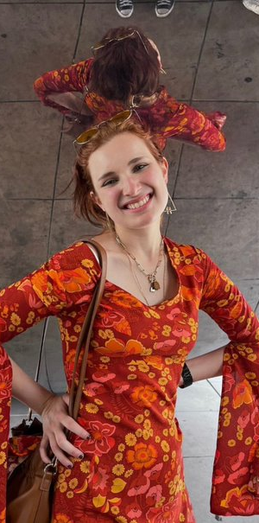
Sarah hurley- co-president
Why FBLA?
What does it mean to be Co-President?
Need to contact Sarah?
(443) 295-5343

Slide 8
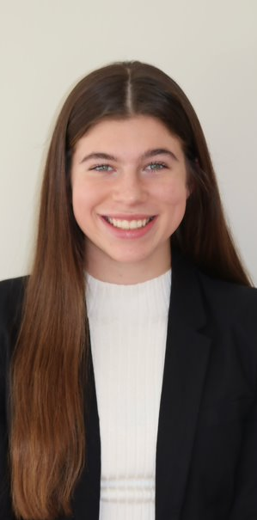
Gentry bowie- co-president
Why FBLA?
What does it mean to be Co-President?
Need to contact Gentry?
(667) 321-7576

Slide 9
Mao yu cheng- vice president
Why FBLA?
What does it mean to be Vice President?
Need to contact Mao Yu?
(667) 321-9072

Slide 10
Cate hall- vice president
Why FBLA?
What does it mean to be Vice President?
Need to contact Cate?
(443) 432-9311

Slide 11
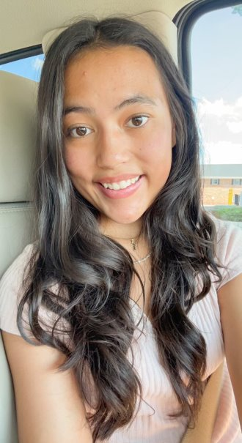
Mikaella jones- vice president
Why FBLA?
What does it mean to be Vice President?
Need to contact Mikaella?
(443) 975-5494

Slide 12
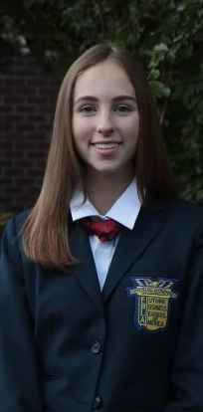
Olivia herrin- secretary
Why FBLA?
What does it mean to be Secretary?
Need to contact Olivia?
(410) 800-7096

Slide 13
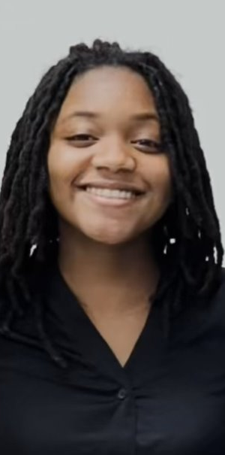
Layla bellamy- treasurer
Why FBLA?
What does it mean to be Treasurer?
Need to contact Layla?
(410) 660-6131

Slide 14
Alee ryon- historian
Why FBLA?
What does it mean to be Historian?
Need to contact Alee?
(301) 758-8977

Slide 15
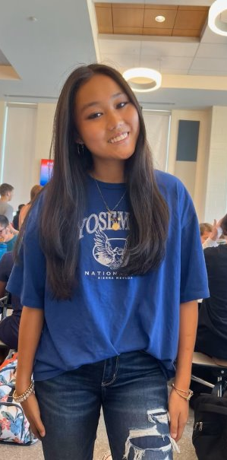
Sarah Hutchinson- Historian
Why FBLA?
What does it mean to be Historian?
Need to contact Sarah?
(443) 694-8434

Slide 16
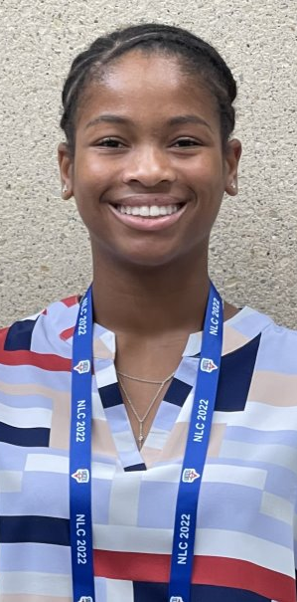
Jasmine simpson- reporter/public relations
Why FBLA?
What does it mean to be Reporter/Public Relations?
Need to contact Jasmine?
(443) 968-5159

Slide 17
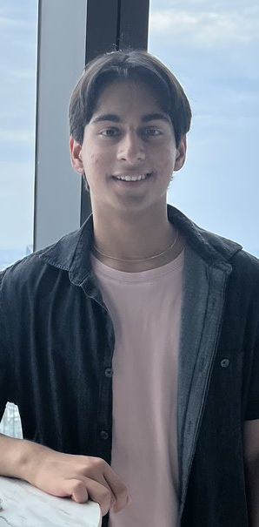
Ajay Singal- Social media coordinator/webmaster
Why FBLA?
What does it mean to be Social Media Coordinator/Webmaster?
Need to contact Ajay?
(443) 750-2149

Slide 18
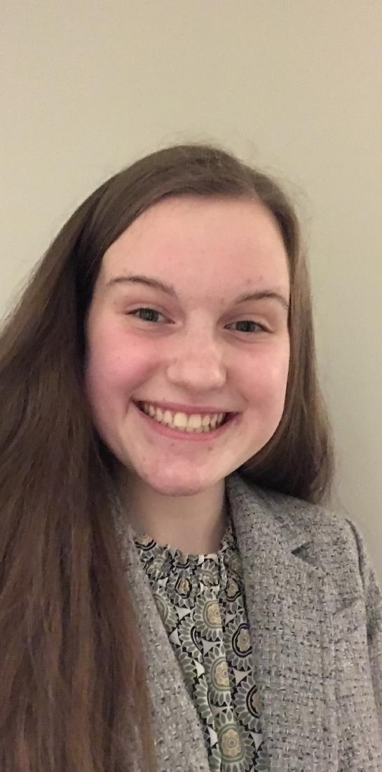
Addison fortenberry- csp coordinator
Why FBLA?
What does it mean to be CSP Coordinator?
Need to contact Addison?
(443) 404-6349

Slide 19
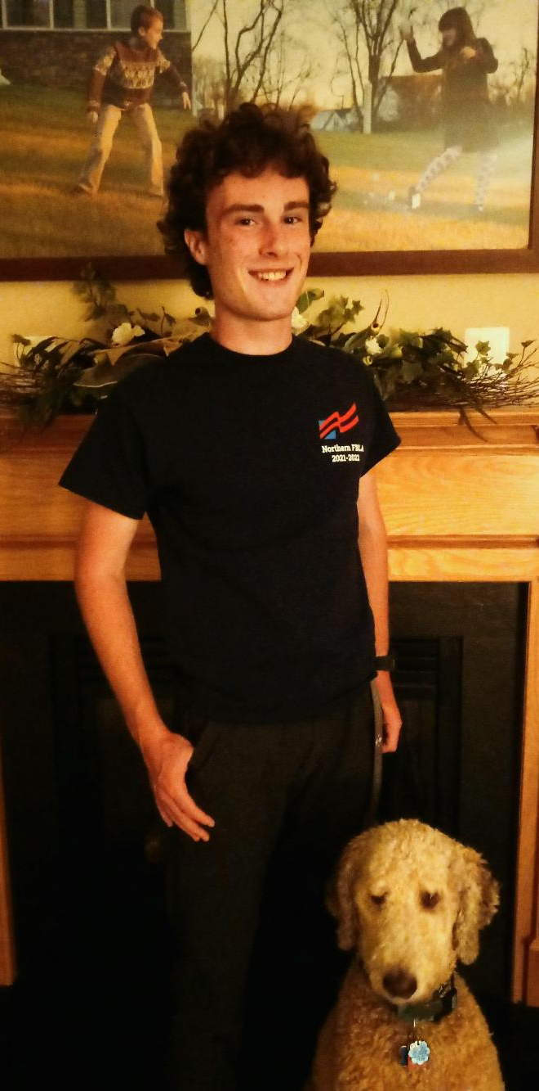
Steven vilcheck- csp coordinator
Why FBLA?
What does it mean to be CSP Coordinator?
Need to contact Steven?
(410) 474-7004

Slide 20
Applications
DUE SEPTEMBER 29TH

Slide 22
Closure
Thank you! Any questions or concerns?

